Slide 1
Abbildungen & Tabellen
Furkan Gürbüz
03703701

Slide 2
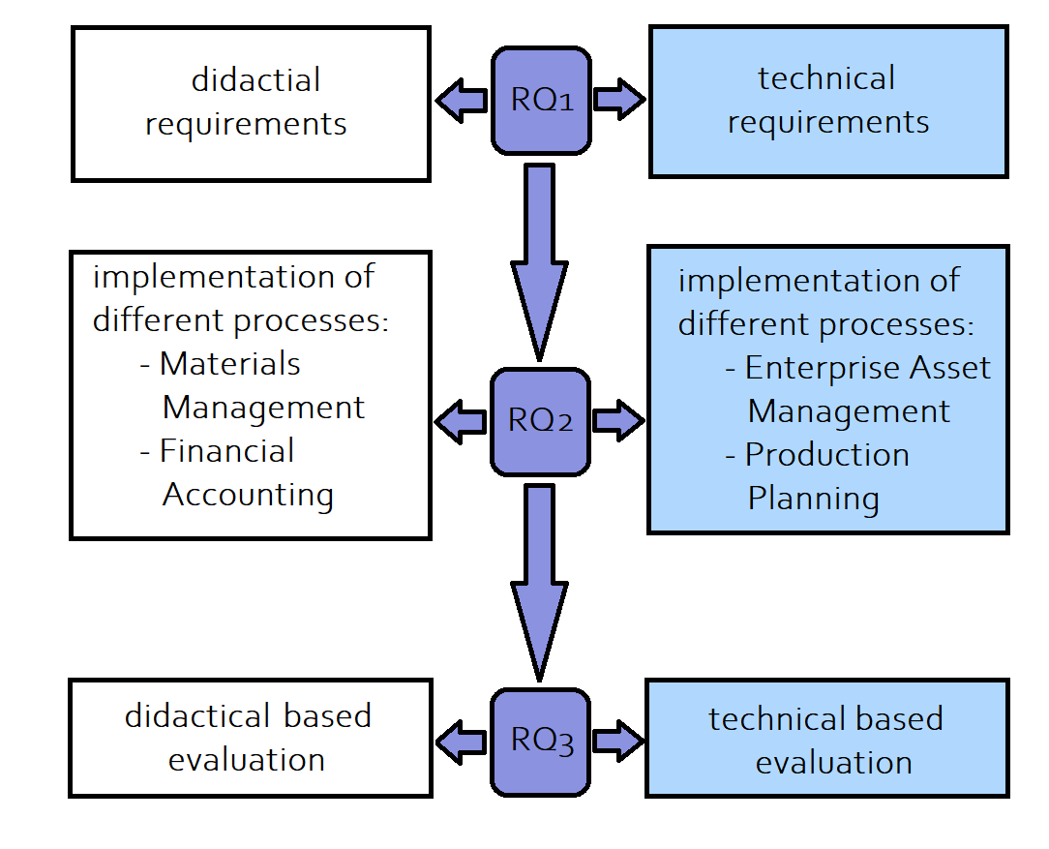
Differentiation

Slide 3
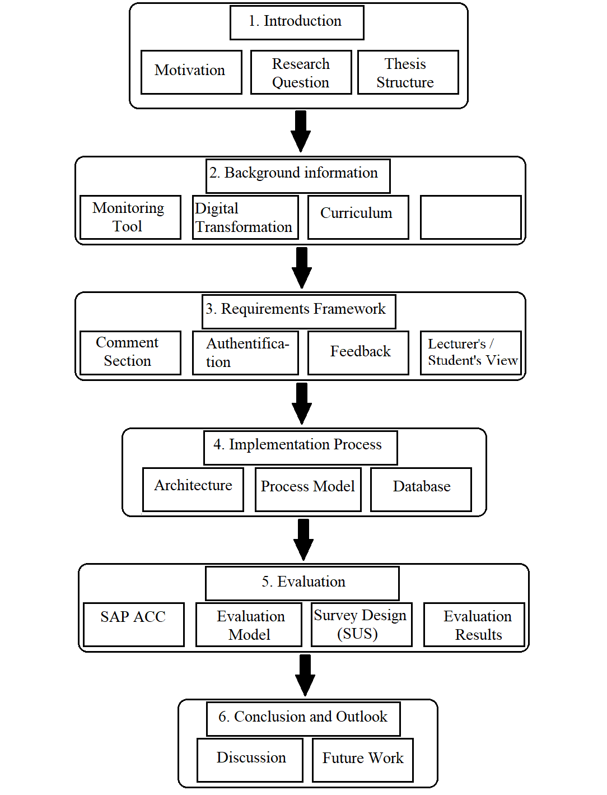
Thesis Structure

Slide 4
Literature Review Methodology
Actions | Results
Review Scope Define the databases to be queried | IEEE Xplore Digital Library, ACM Digital Library, AISeL, Scopus
Topic Conceptualization Only consider journal and conference articles using 2 queries. | 479 total papers have been found
Literature Review Scanning of titles and abstracts | 35 papers are considered relevant
Literature Analysis and Synthesis Reading the remaining papers | 10 papers contain statements that can be transformed into requirements
Research Agenda Formulation requirements | 24 requirements of 6 categories

Slide 5
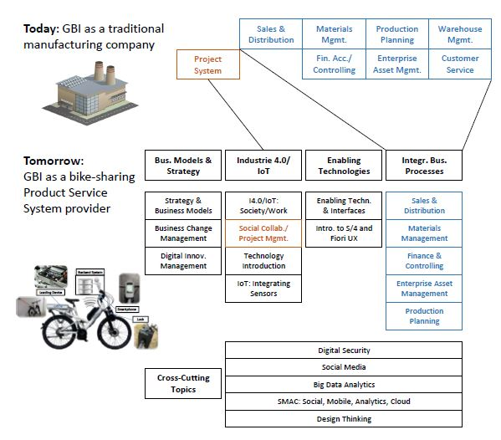
Modules of Global Bike Company

Slide 6
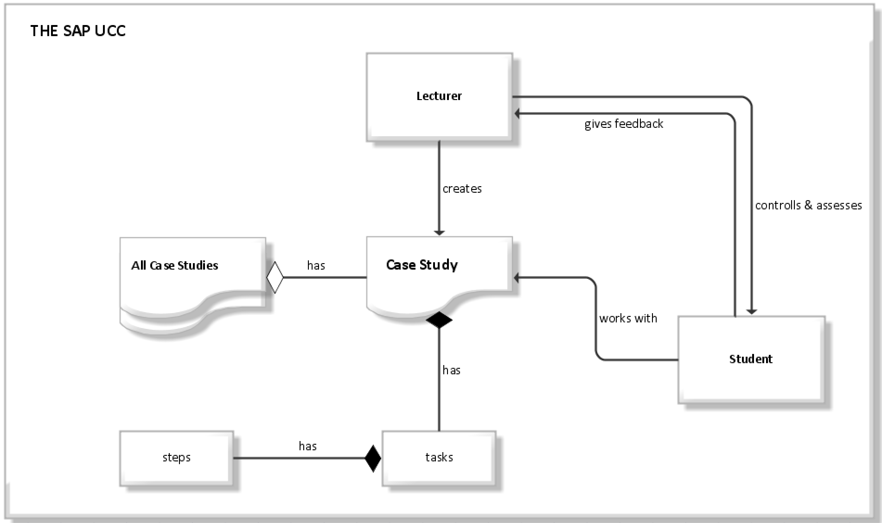
SAP UCC Case Studies

Slide 7
Use Case Organizational 1
Use Case | Login into the system (UC_OR1)
Goal | Users can log in to the system and the system can detect the currently logged-in user.
Preconditions | The User knows his/her login details
Actor(s) | Lecturer/Student
Main Success Scenario | 1. | Lecturer/Student | types in the username
 | 2. | Lecturer/Student | types in the password
 | 3. | System | checks input values with the data values saved in the database: If input values are true redirects to the landing page; Else give out an error message
 | 4. Case: false | Lecturer/Student | starts from step 1 again.
 | 4. Case: true | System | checks the login details: If the username starts with GBS, then redirect to the student landing page; Else redirect to the lecturer landing page

Slide 8
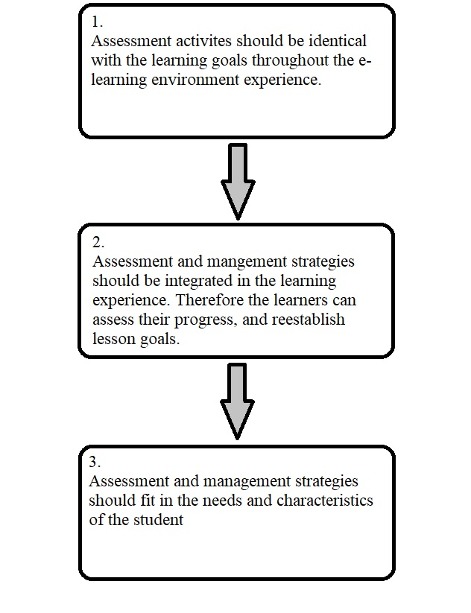
Guidelines for e-learning assessment

Slide 9
Use Case Default 1
Use Case | The student selects a case study (UC_D1)
Goal | The student wants to select the desired case study
Preconditions | The student opened the website and logged himself/herself in (UC_OR1).
Actor(s) | Student
Main Success Scenario | 1. | Student | clicks on dropbox
 | 2. | System | showcases hardcoded case study values
 | 3. | Student | clicks on desired case study
 | 4. | Student | clicks on arrow
 | 5. | System | checks entry values: If true redirect to the next page; Else give out an error message

Slide 10
Use Case Default 2
Use Case | The student sees the data (UC_D2)
Goal | The Student wants to see the data of the selected case study (which he/she selected in UC_D1)
Preconditions | The Student has done the actions of UC_D1, and the if case was identified as true by the system!
Actor(s) | Student
Main Success Scenario | 1. | System | loads data from backend from specific student and case study
 | 2 | Student | scrolls through the data and assesses his results

Slide 11
Use Case Admin 1
Use Case | Lecturer Selection of Student & Case Study (UC_A1)
Goal | The Lecturer wants to select a specific student within a specific case study
Preconditions | The Lecturer opened the website and logged himself/herself in (UC_OR1).
Actor(s) | Lecturer
Main Success Scenario | 1. | Lecturer | clicks on the first dropbox
 | 2. | System | loads data from the backend
 | 3. | Lecturer | clicks on desired student ID
 | 4. | Lecturer | clicks on the second dropbox
 | 5. | System | showcases hardcoded case study values
 | 6. | Lecturer | clicks on desired case study
 | 7. | Lecturer | clicks on the arrow button to go to the next page
 | 7. | System | checks entry values: If true redirect to the next page; Else give out an error message

Slide 12
Use Case Admin 2
Use Case | Lecturer visualized the data (UC_A2)
Goal | The Lecturer wants to see the data of the selected student and case study (which he selected in UC_A1)
Preconditions | The Lecturer has done the actions of UC_A1, and the if case was identified as true by the system!
Actor(s) | Lecturer
Main Success Scenario | 1. | System | loads data from backend from specific student and case study
 | 2 | Lecturer | scrolls through the data and monitors the results

Slide 13
Use Case Admin 3
Use Case | Comment functionality for the lecturer (UC_CA1)
Goal | The Lecturer wants to write a comment for the student within a case study, which were selected in UC_A1
Preconditions | The Lecturer has already done UC_A1
Actor(s) | Lecturer
Main Success Scenario | 1. | Lecturer | can write a comment on the student's task performance, or activity behavior, or learning progress for the selected case study and student
 | 2. | Lecturer | clicks on the comment section field and types in the comment
 | 3. | Lecturer | clicks on the send button
 | 4. | System | saves the typed-in comment into the database, with the specific user id and case study id.
 | 5. | System | If an error occurred during step 4, then the error message box is visualized; Else success message box is visualized

Slide 14
Use Case Admin 4
Use Case | Comment functionality for the student (UC_CD1)
Goal | The Student wants to write a comment for the lecturer within a case study, which were selected in UC_D1
Preconditions | The Student has already done UC_D1
Actor(s) | Student
Main Success Scenario | 1. | Student | clicks on the comment section field and types in the comment
 | 2. | Student | Clicks on the send button.
 | 3. | System | saves the typed-in comment into the database, with the specific case study id.
 | 4. | System | If an error occurred during step 3, then the error message box is visualized; Else success message box is visualized

Slide 15
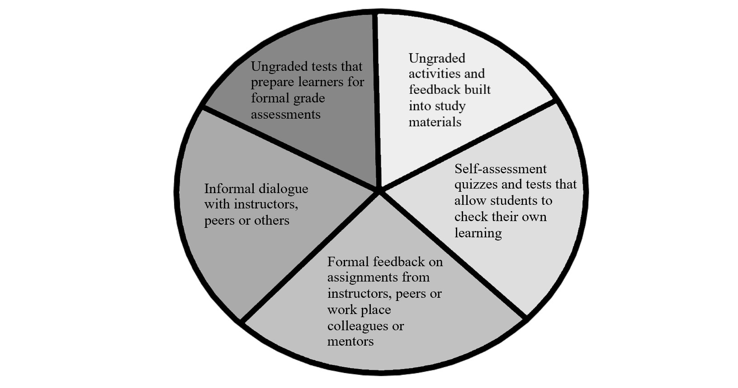
Assessment categories

Slide 16
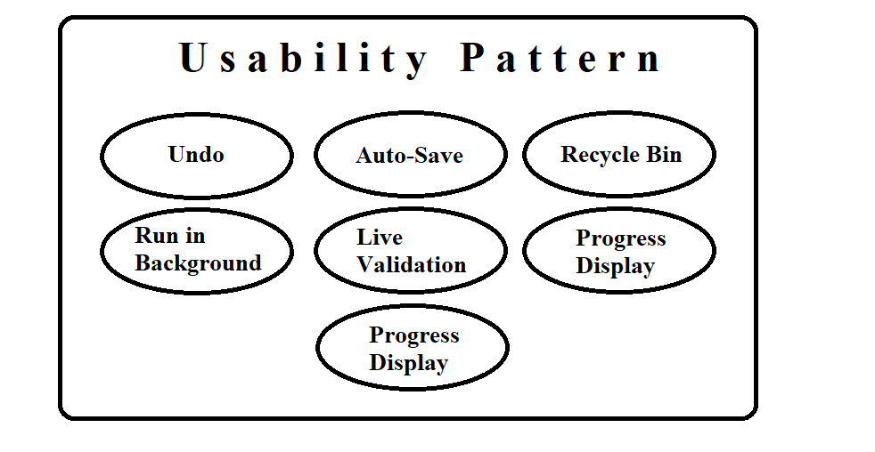
Usability Pattern

Slide 17
Requirements from literature review
Requirement Identifier | Requirement Description
/OR01/ Access control | The system should differentiate between Admin and Default user, who has different levels of restrictions and adapt the UI accordingly
/SoAA01/ Fetching data of individual default user | The admin should be able to fetch students data from the database with a dialog (calling students id)
/SoAA02/ Fetching data of case study | The admin should be able to fetch data of selected case study from a drop-down menu
/SoAA03/ Visibility of data | The admin should be able to confirm and graphically see the data by pressing a button
/SoAA04/ Deletion of Selection | Admin can delete the entries (UI based) from SoAA01 and SoAA02
/SoAA05/ Activity Control | The admin can monitor the activity of the student. Therefore every SoAD needs to have a unique identifier, which needs to be saved in the database.
/CS01/ Admin Comment | The admin should be able to comment inside a comment section on the student's solution (asynchronous interaction).
/CS02/ Default User Comment | The default user should be able to respond to the comment of the admin or write a new comment to the admin (asynchronous interaction).
/CS03/ Visibility | The Comments inside the comment section are only visible for concerned users
/SoAD01/ Selecting Case Studies | The default user should be able to select a specific case study from a drop-down menu.
/SoAD02/ Visibility of Selection | The default user should be able to confirm and graphically see his/her results by pressing a button.
/SoAD03/ Delete selection | The default user should be able to delete (UI-based) the selection of SoAD01.
/SoAD04/ Overall Success rate | The default user should be able to see the overall success/failure rate by clicking on a button.
/FB01/ Admin feedback | the admin should be able to give a total grade/points for the selected default user within the whole case study. This feedback should be only visible to the concerned user. Therefore the points/grade has to be saved with the default users id
/FB02/ Default User feedback | The default user should have once permission to give feedback to the admin for a specific case study. This feedback should be sent (and saved in the database) to the admin's feedback page
/FB03/ Visibility feedback page (Admin) | The admin should be able to see all the feedback gathered on the feedback page (send by FB02).
/FB04/ Visibility feedback page (Default user) | The default user just should see one feedback for each case study on his/her feedback page (from FB01).
/NF07/ Usability | The user should be able to navigate throughout the tool within 3 steps

Slide 18
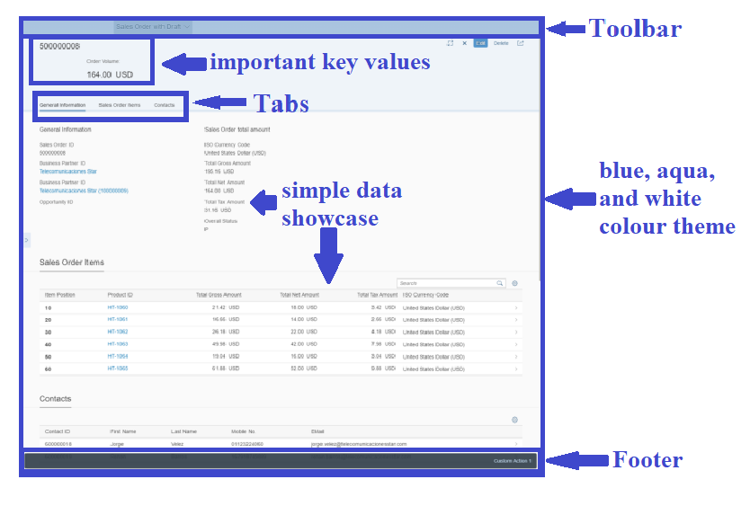
Basic Fiori UI Sample

Slide 19
Requirements from existing solutions
Requirement Identifier | Requirement Description
/NF01/ Accessibility | The tool should be accessible with web browsers (Firefox, Chrome, etc.)
/NF02/ Response Time | The average response time should be less than 5 seconds
/NF03/ Availability | The tool should be available 99% times
/NF04/ Language | The tool should be in German and English
/NF05/ Event of Failure | When the tool crashes, it should be able to back up to its previous state
/NF06/ Design | The tool should maintain the overall design concept of SAP FIORI

Slide 20
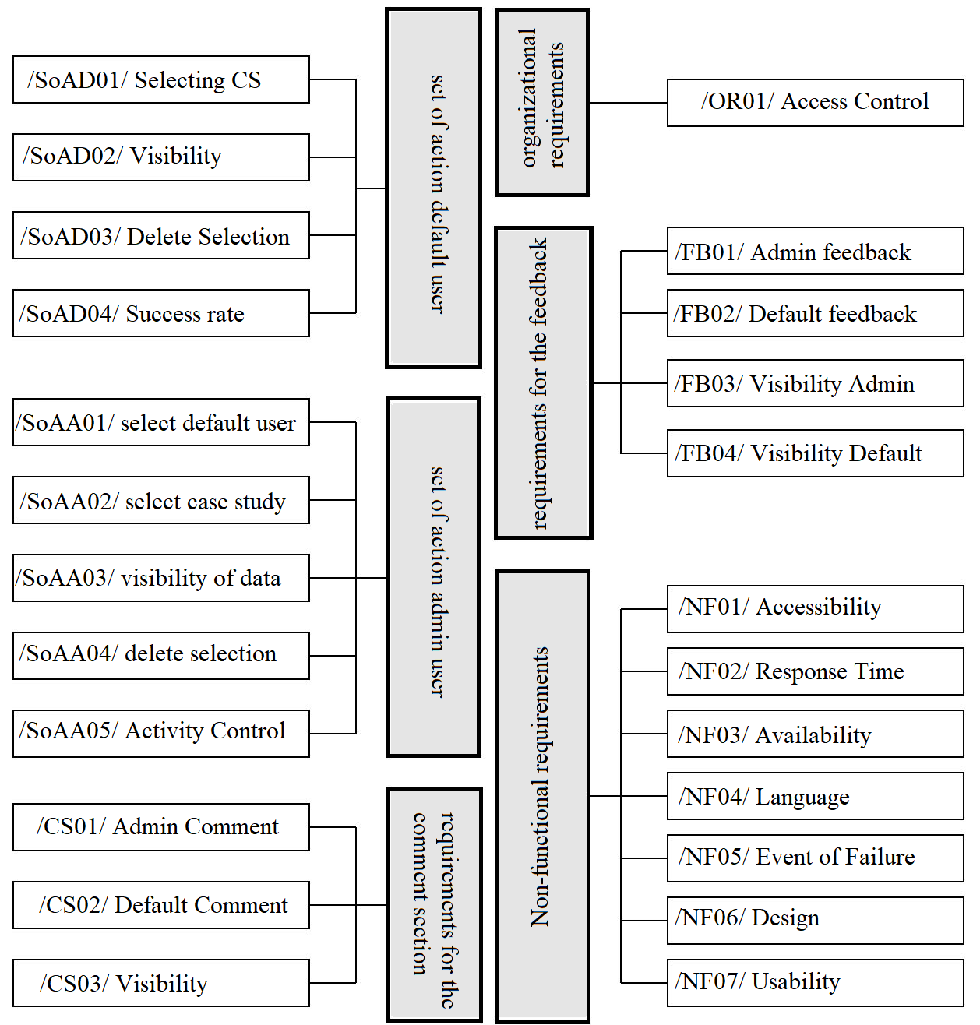
Requirement Results

Slide 21
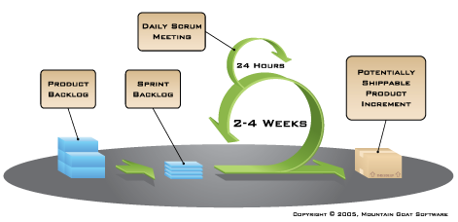
Typical Scrum lifecycle model

Slide 22
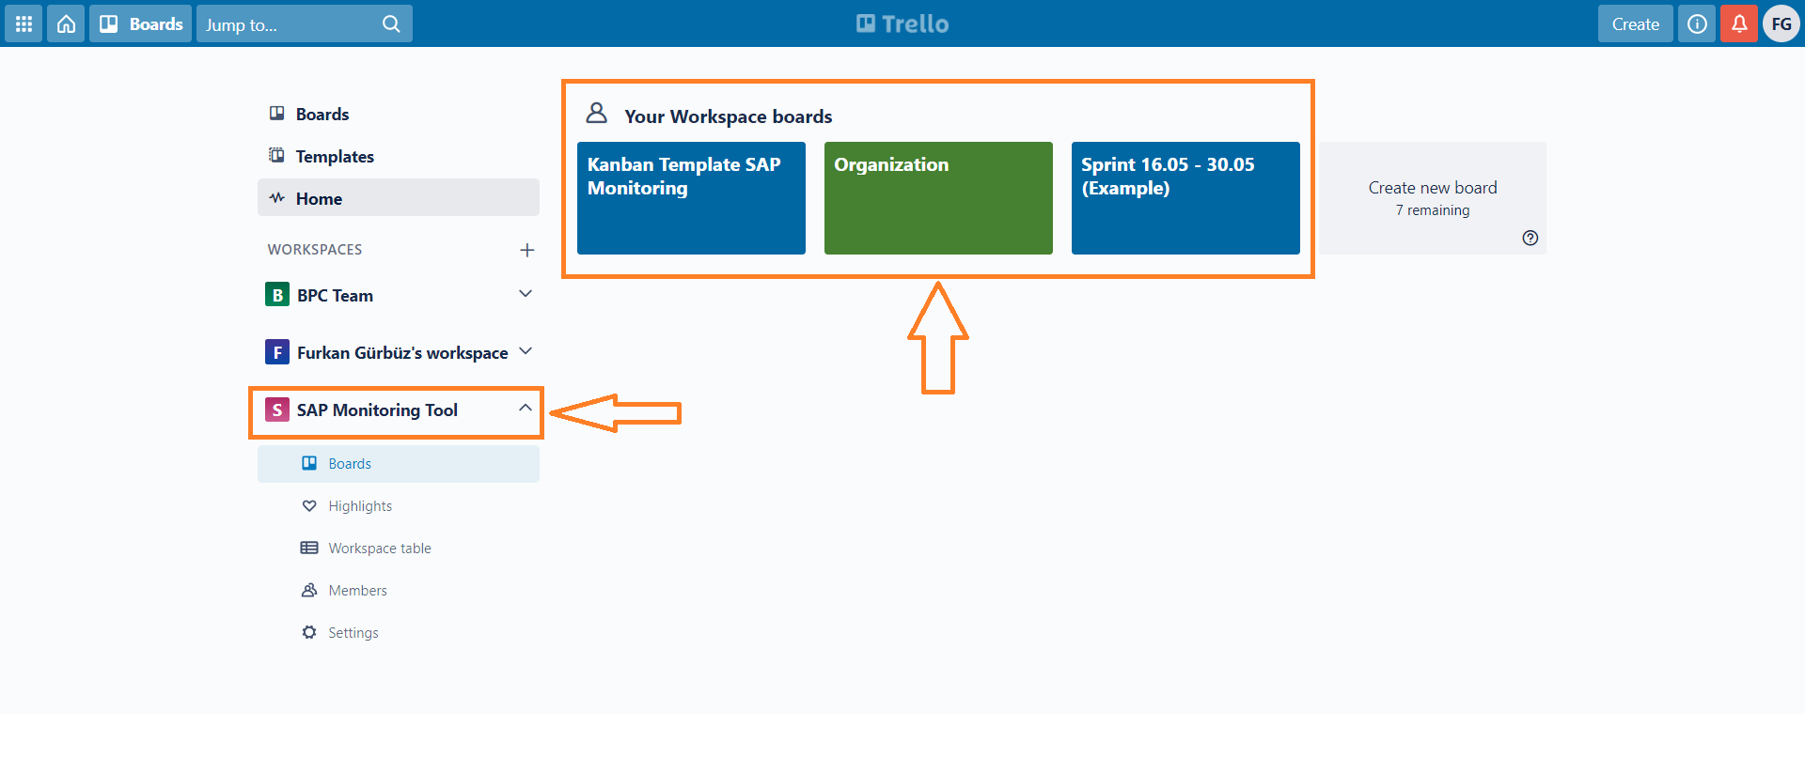
Trello Workspace

Slide 23
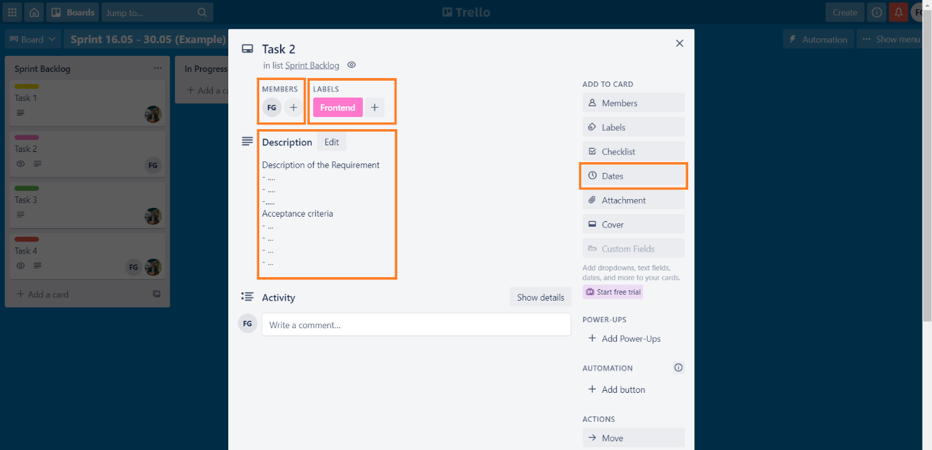
Trello Task description

Slide 24
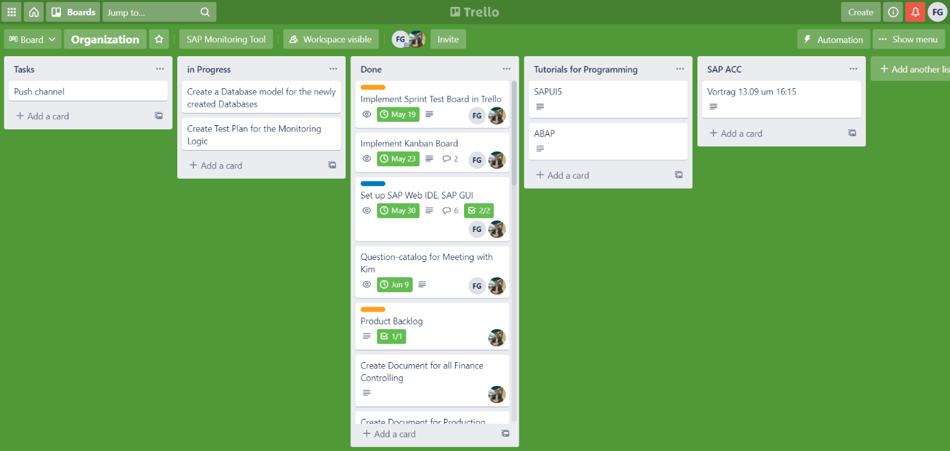
Trello Organizational Board

Slide 25
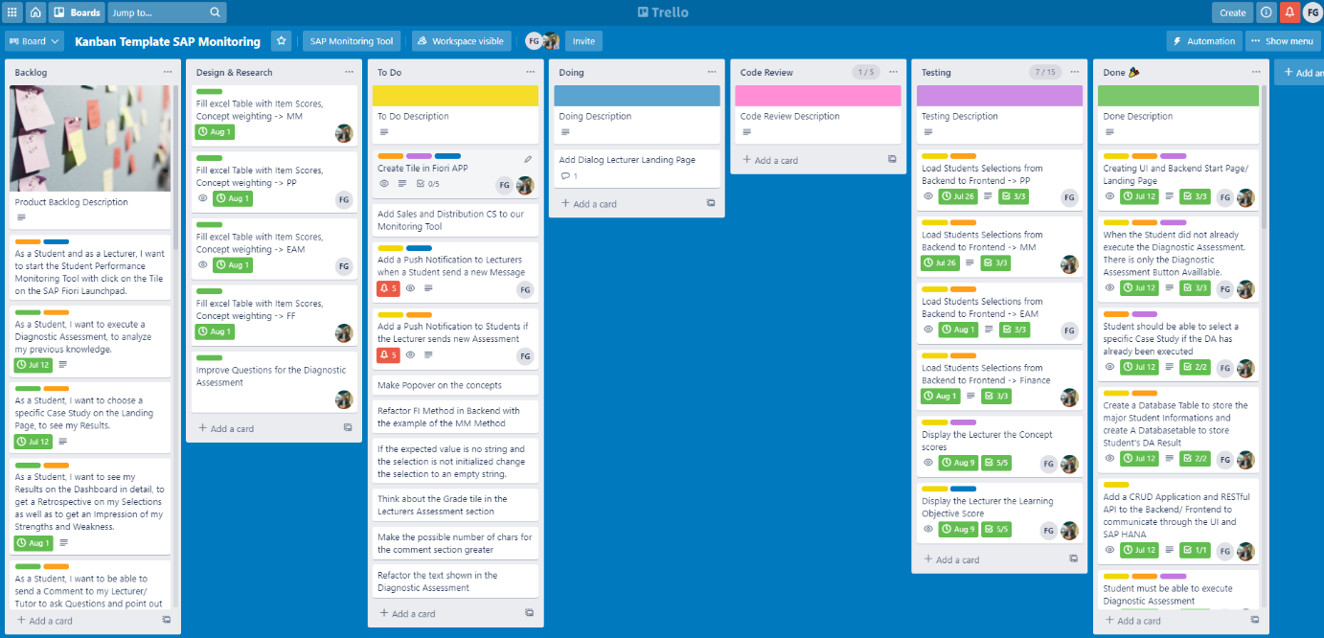
Trello Main Kanban Board

Slide 26
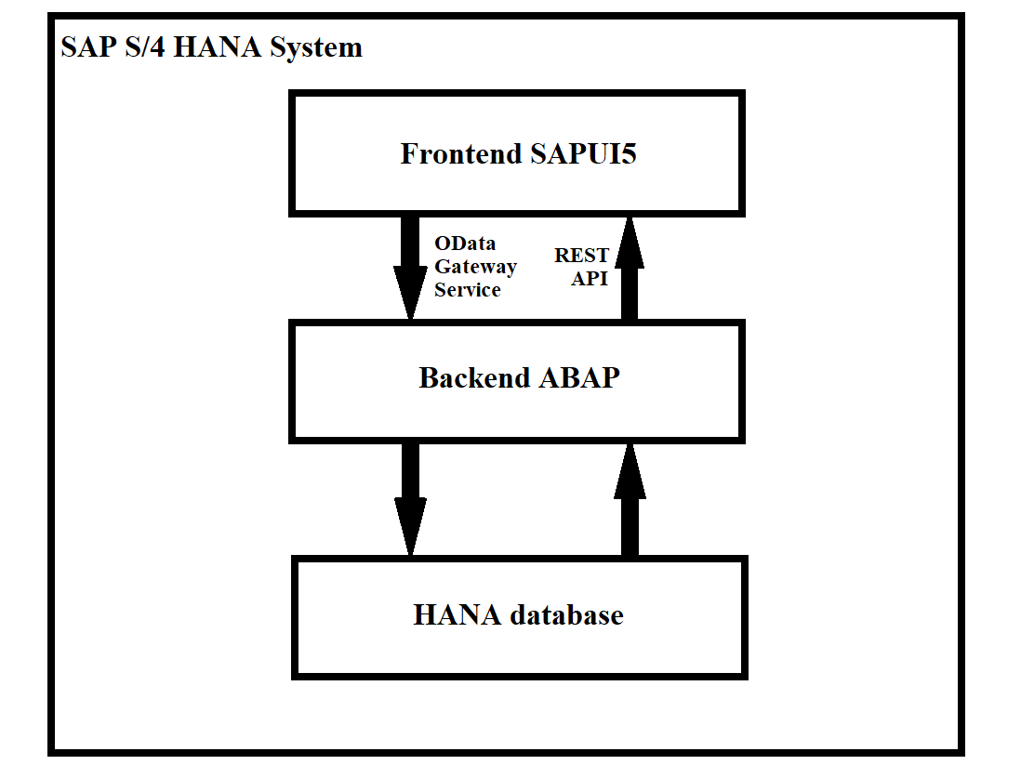
SAP S/4 Hana System

Slide 27
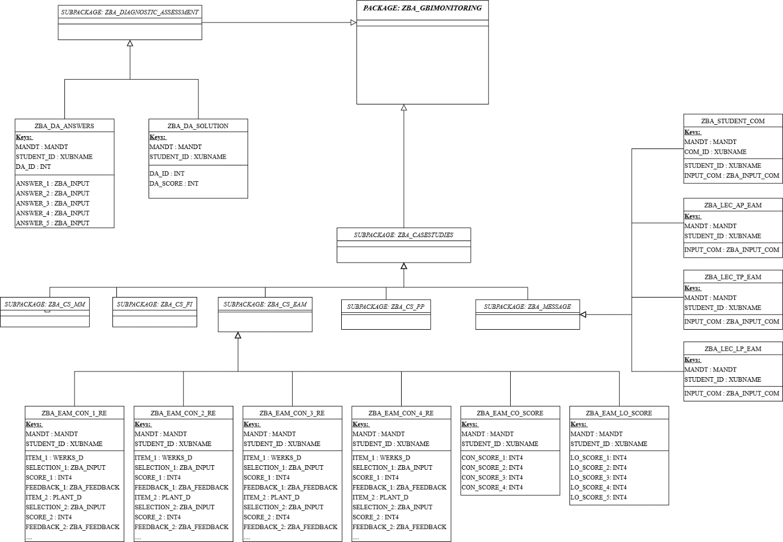
Conceptual UML data model

Slide 28
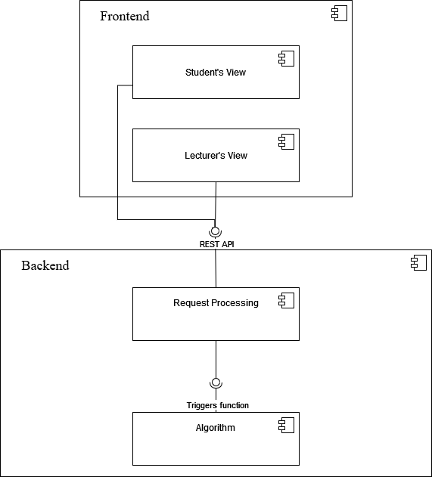
Component diagram

Slide 29
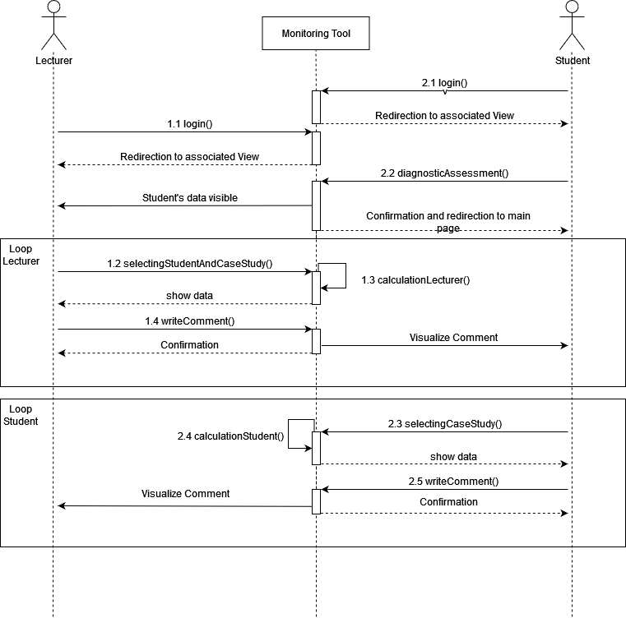
Sequence diagram

Slide 30
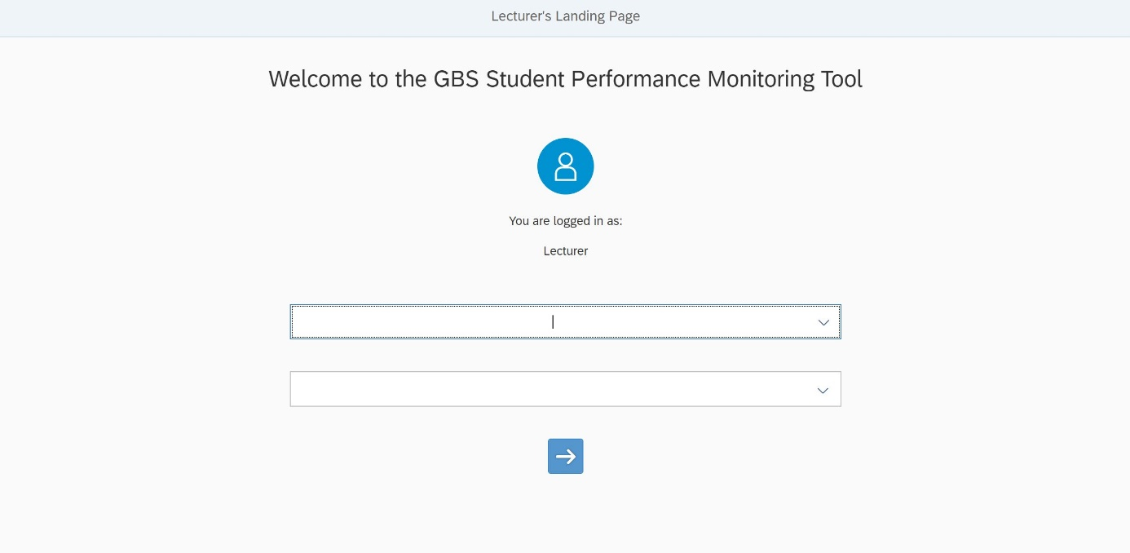
Lecturer Landing Page

Slide 31
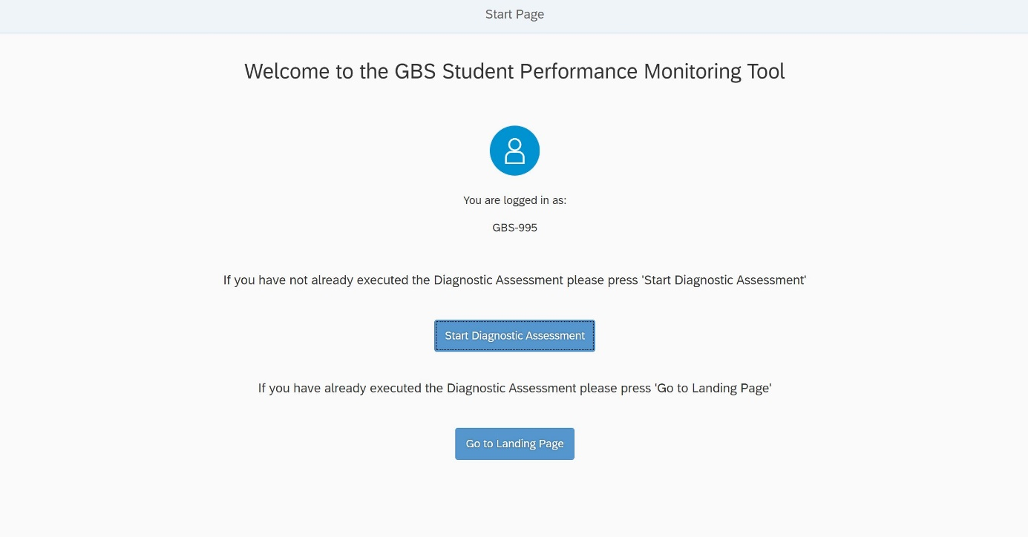
Student Pre-landing Page

Slide 32
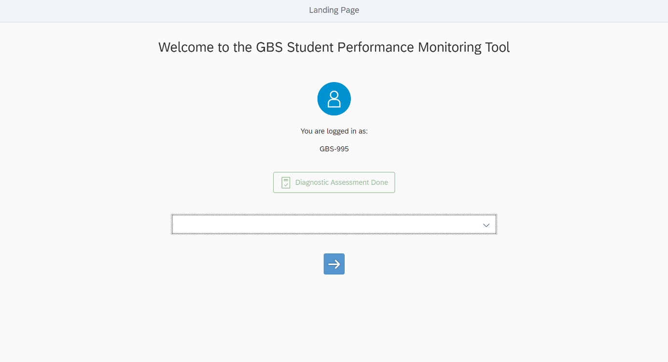
Student Landing Page

Slide 33
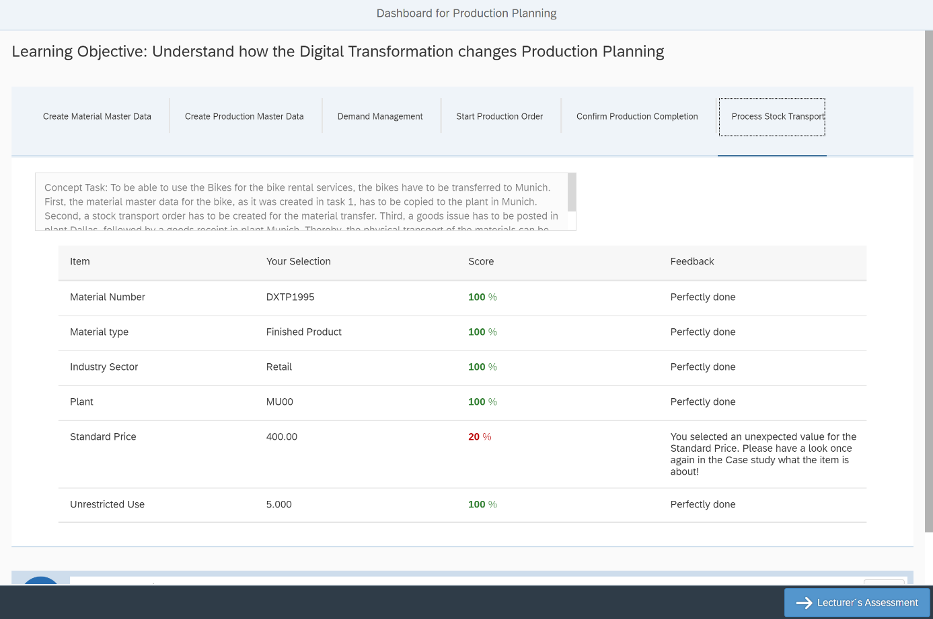
Student Dashboard for Production Planning

Slide 34
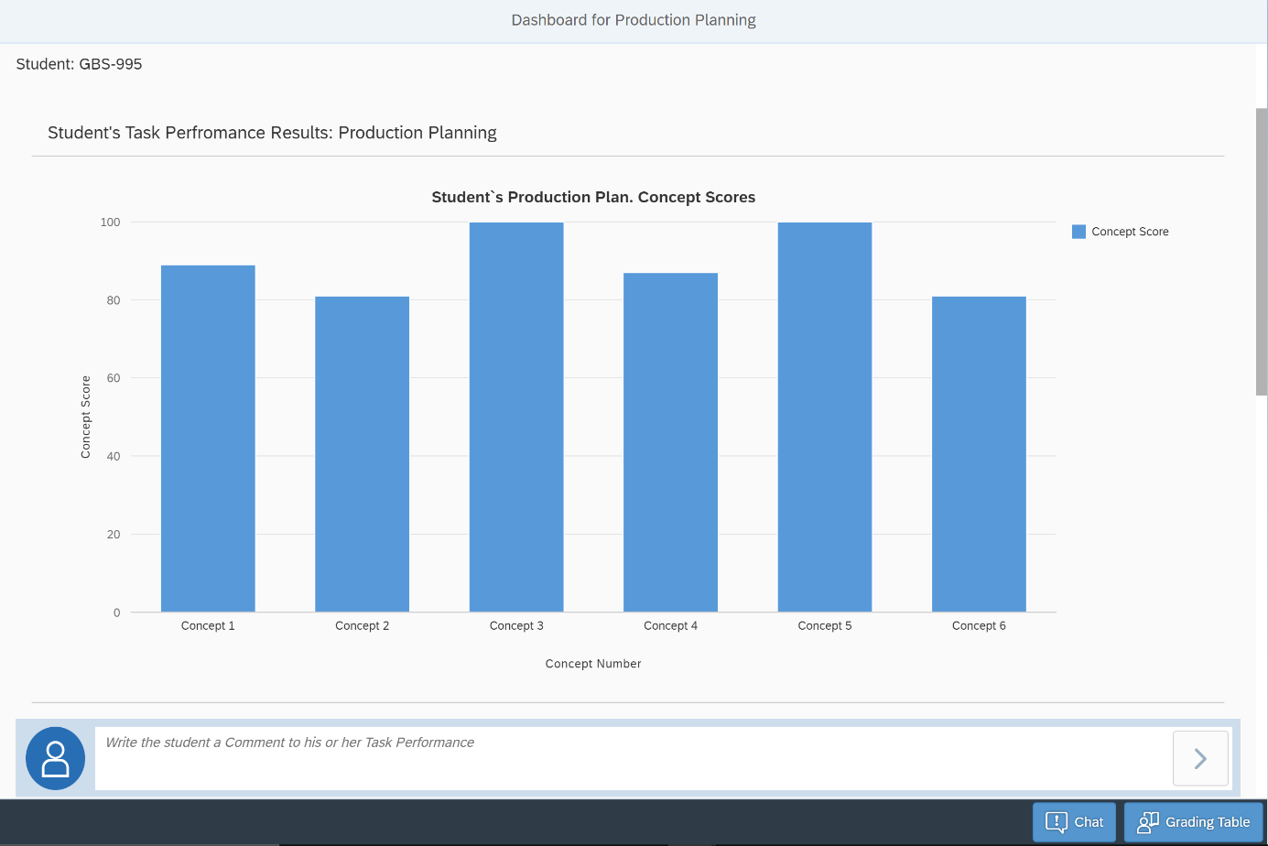
Lecturer Dashboard for Production Planning

Slide 35
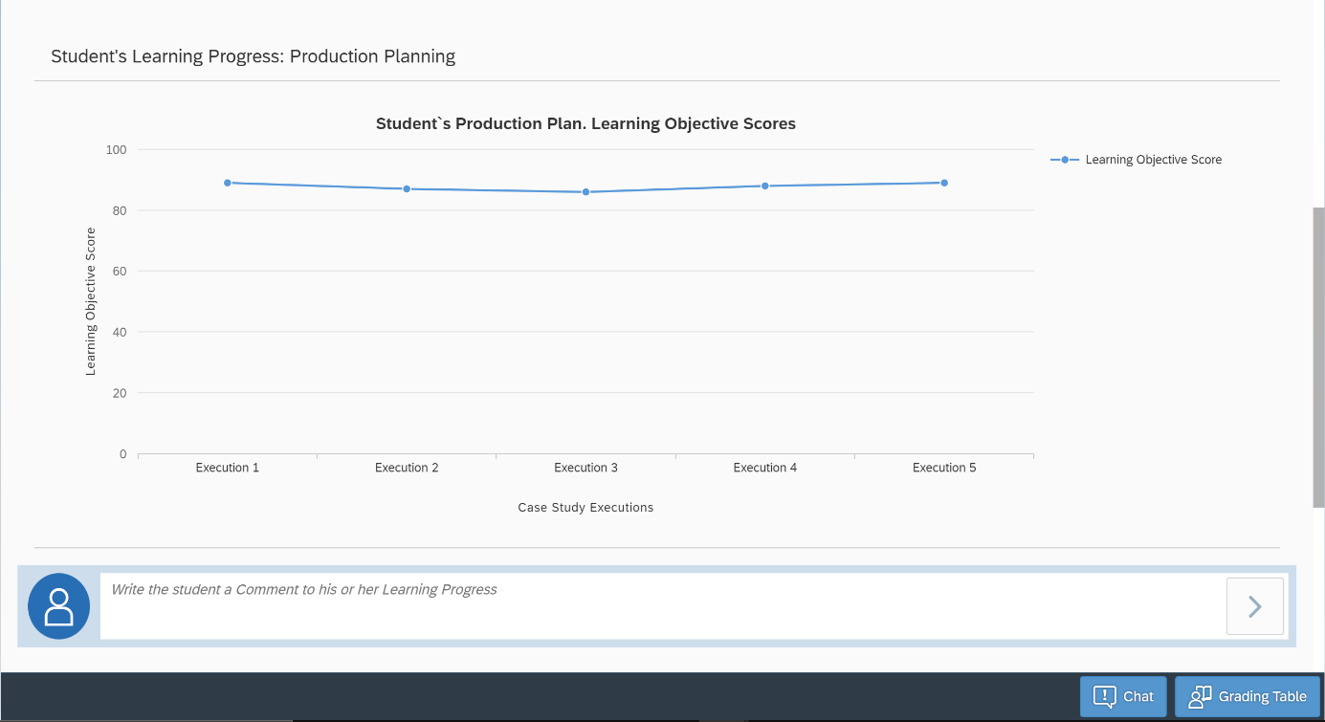
Dashboard for Production Planning 2

Slide 36
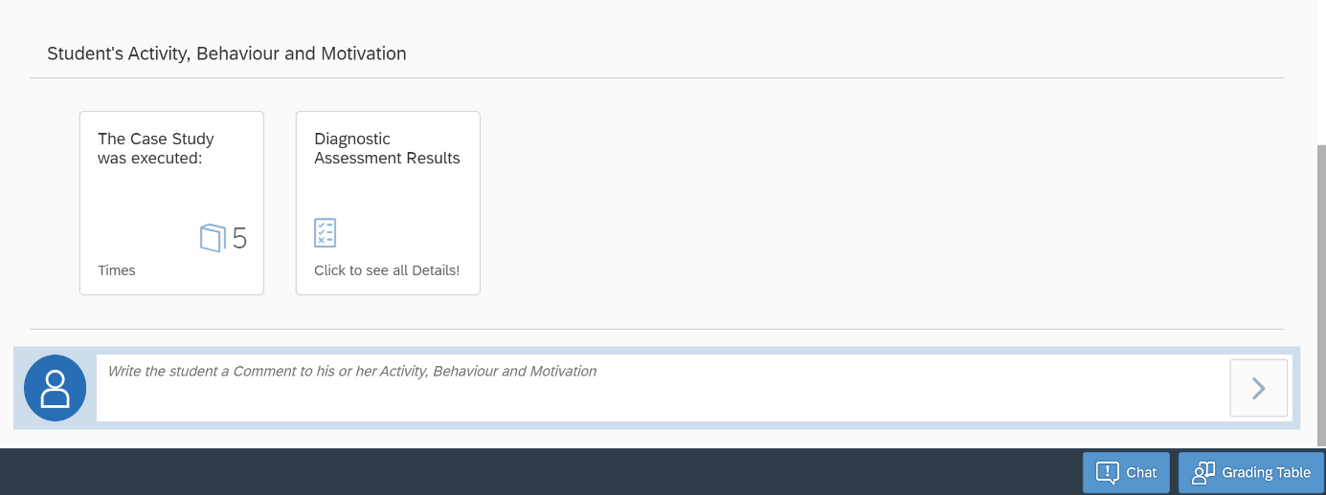
Dashboard for Production Planning 3

Slide 37
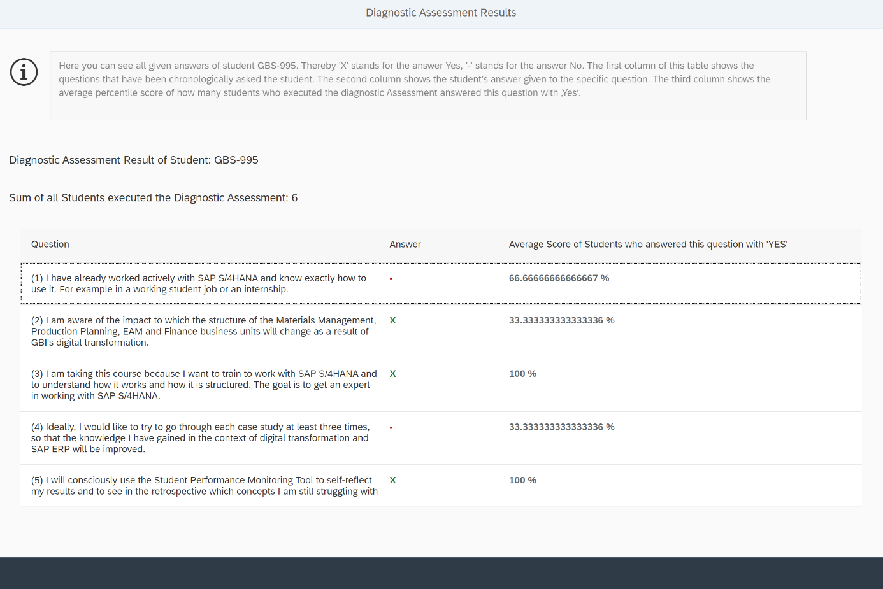
Diagnostic Assessment Results Page

Slide 38
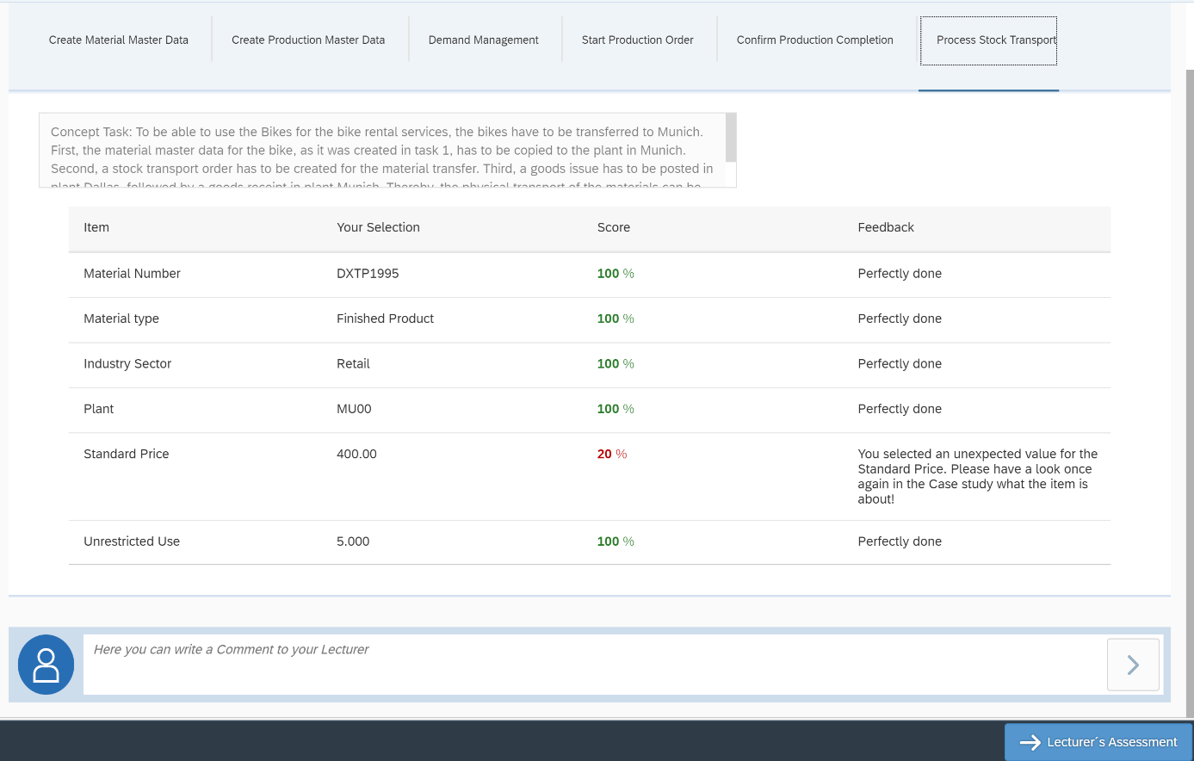
Comment functionality Student

Slide 39
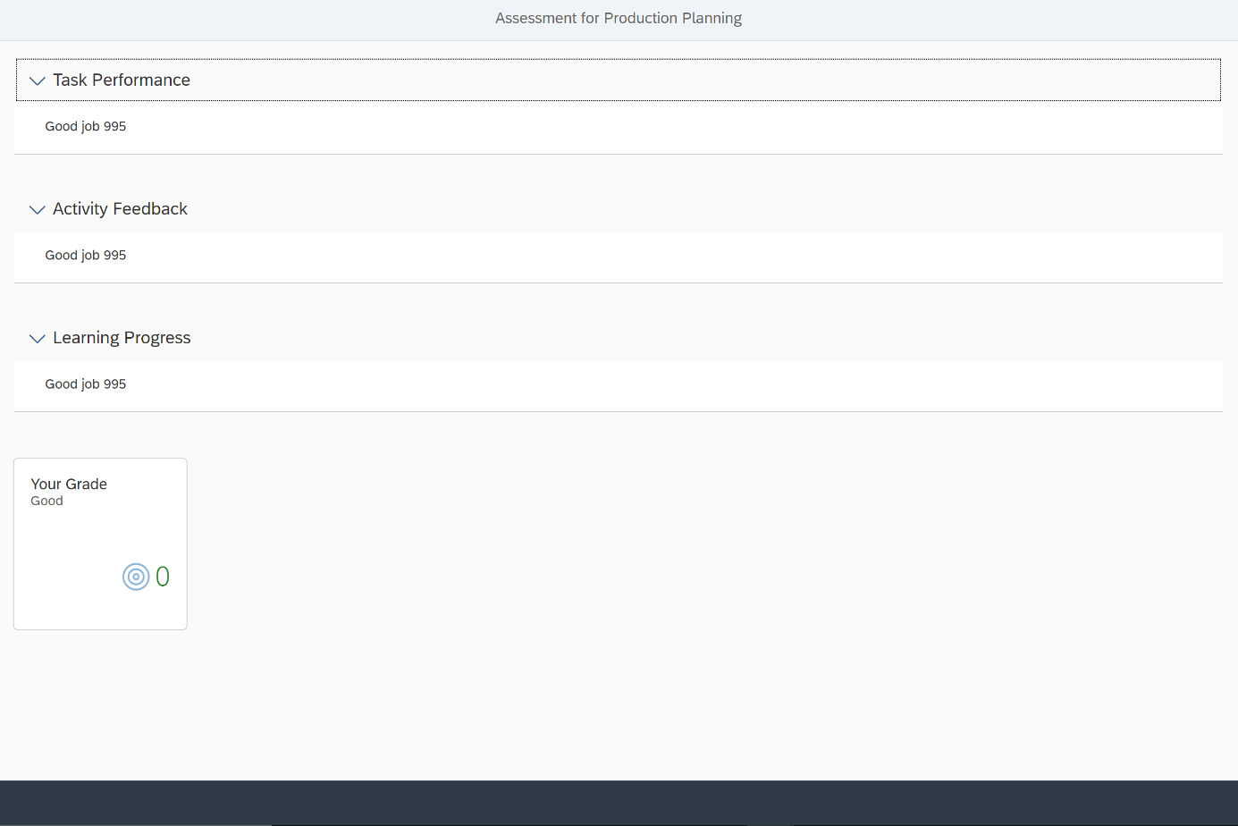
Lecturer‘s assessment Page

Slide 40
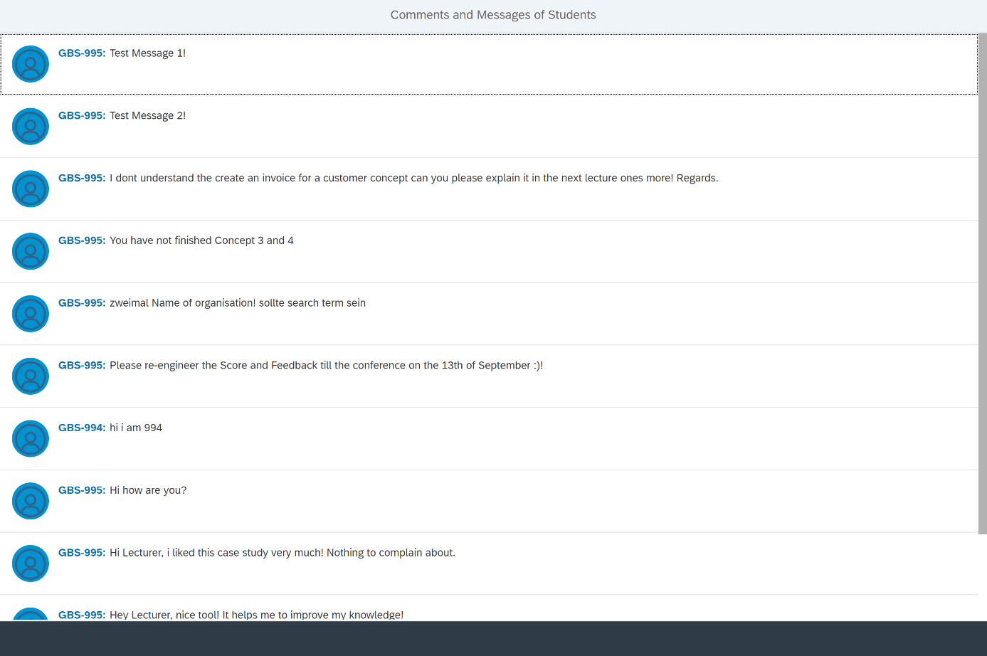
Comments and Messages from Students

Slide 41
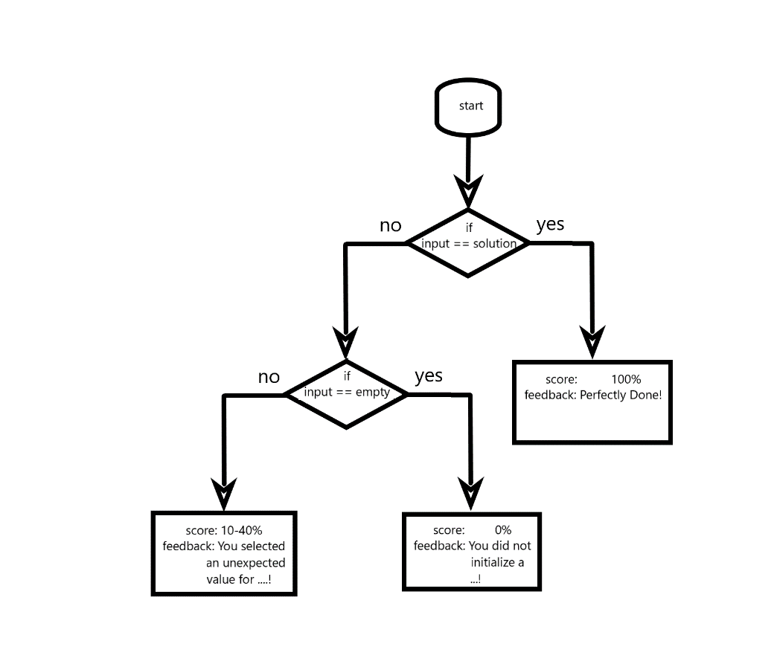
Conceptual model for feedback generation

Slide 42
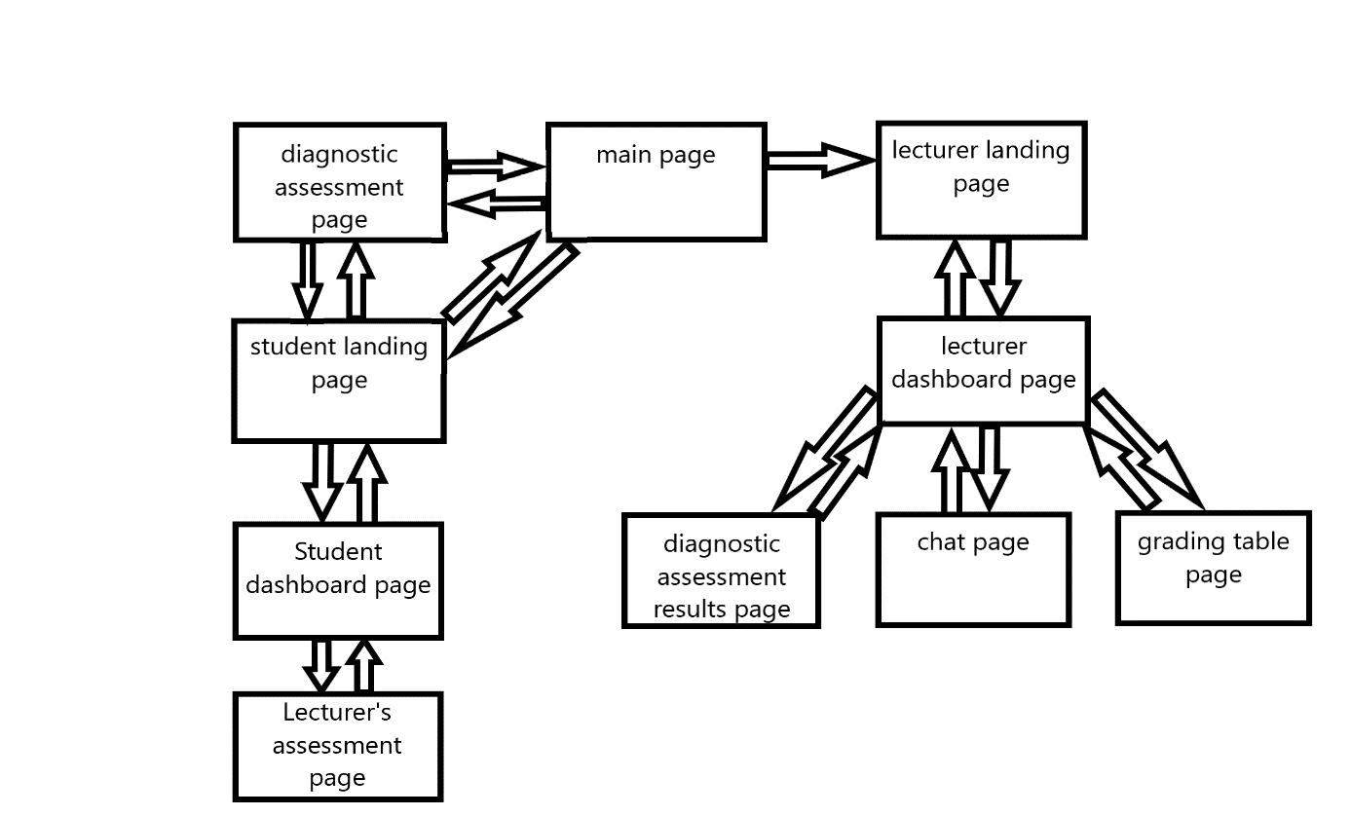
Click-flow and pages diagram

Slide 43
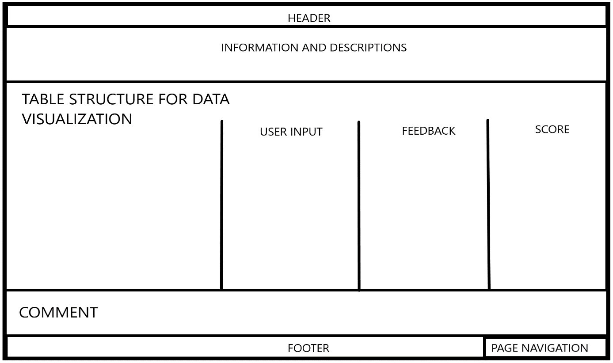
Mock-up Page for Student

Slide 44
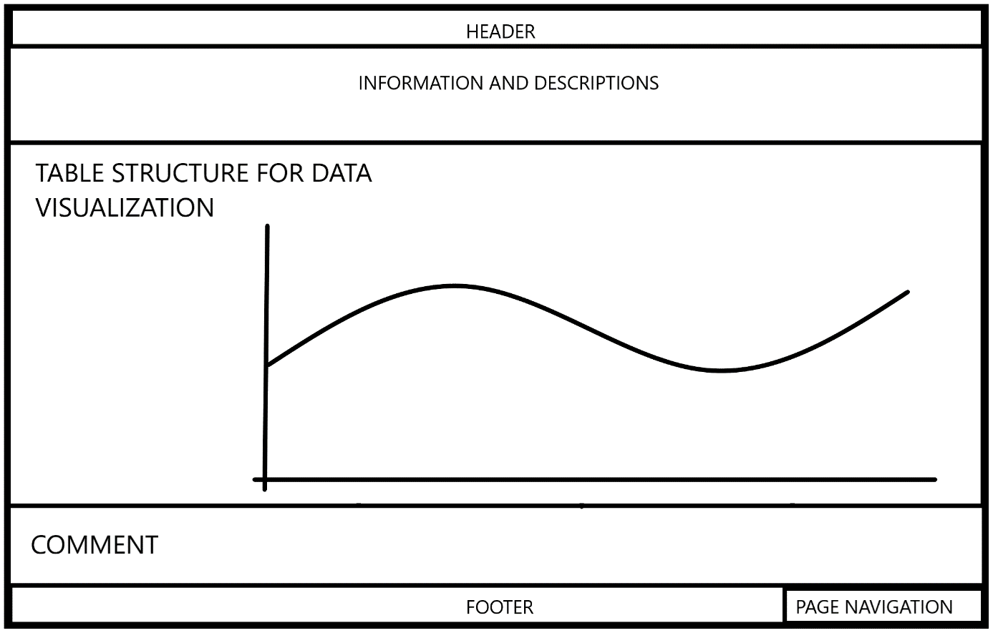
Mock-up Page for Lecturer

Slide 45
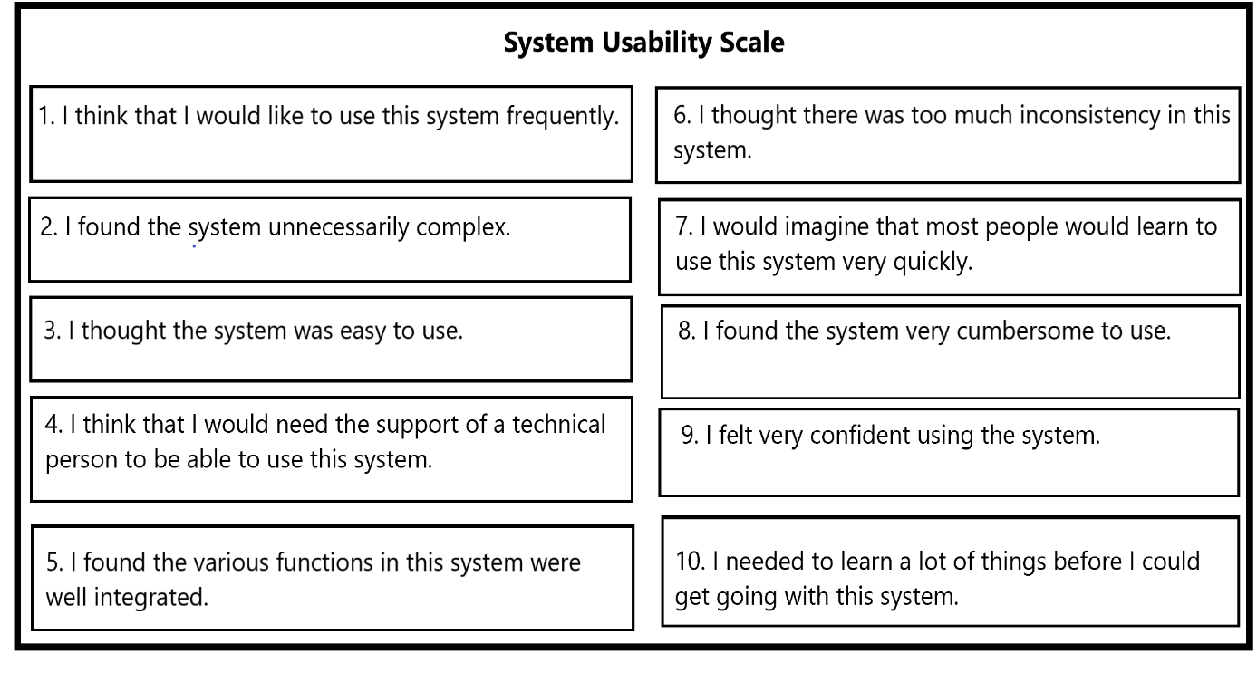
System Usability Scale

Slide 46
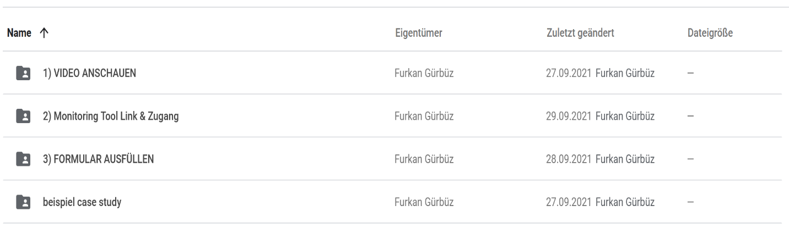
Evaluation folder in Google Drive

Slide 47
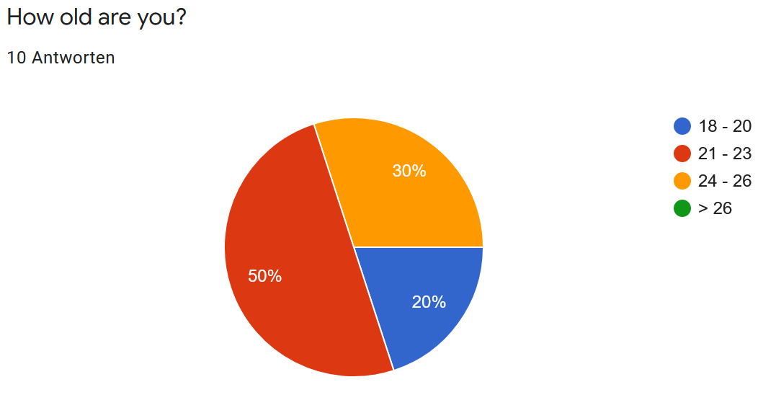
Age Distribution

Slide 48
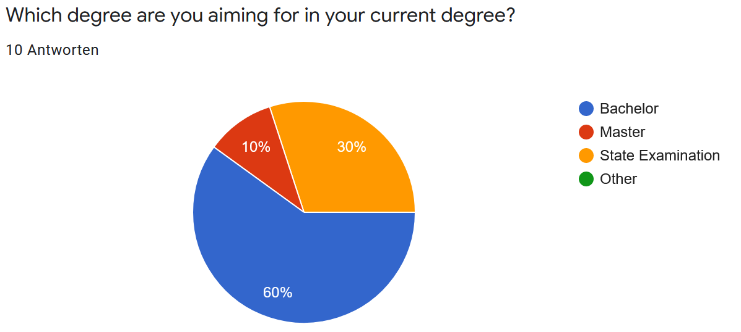
Degree Distribution

Slide 49
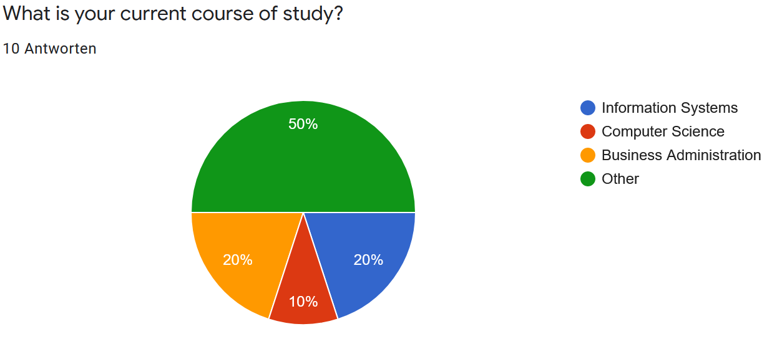
Course of Study Distribution

Slide 50
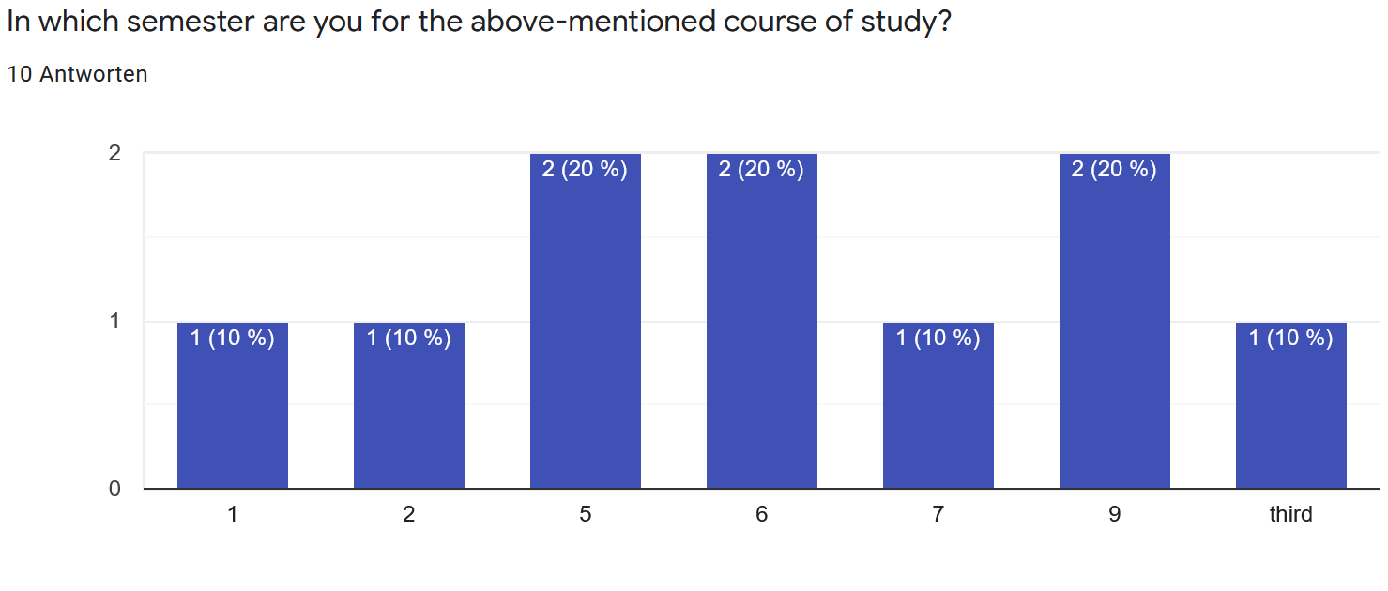
Semester Distribution

Slide 51
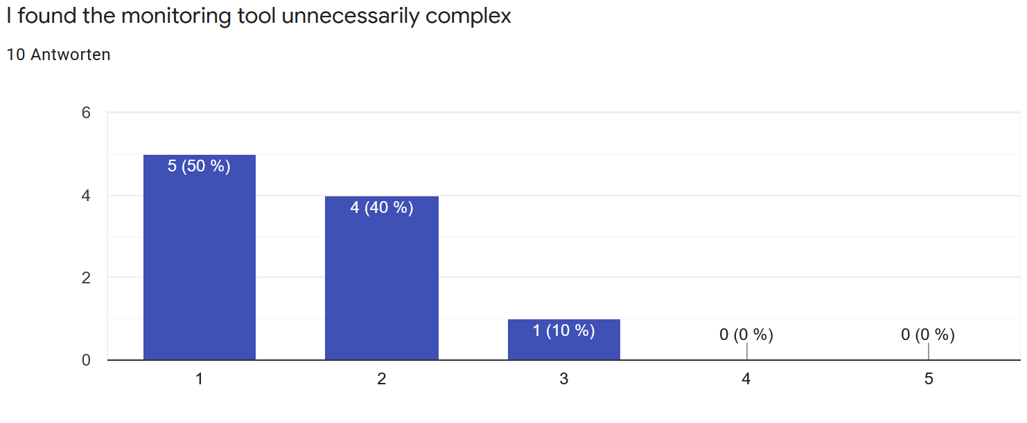
Complexity

Slide 52
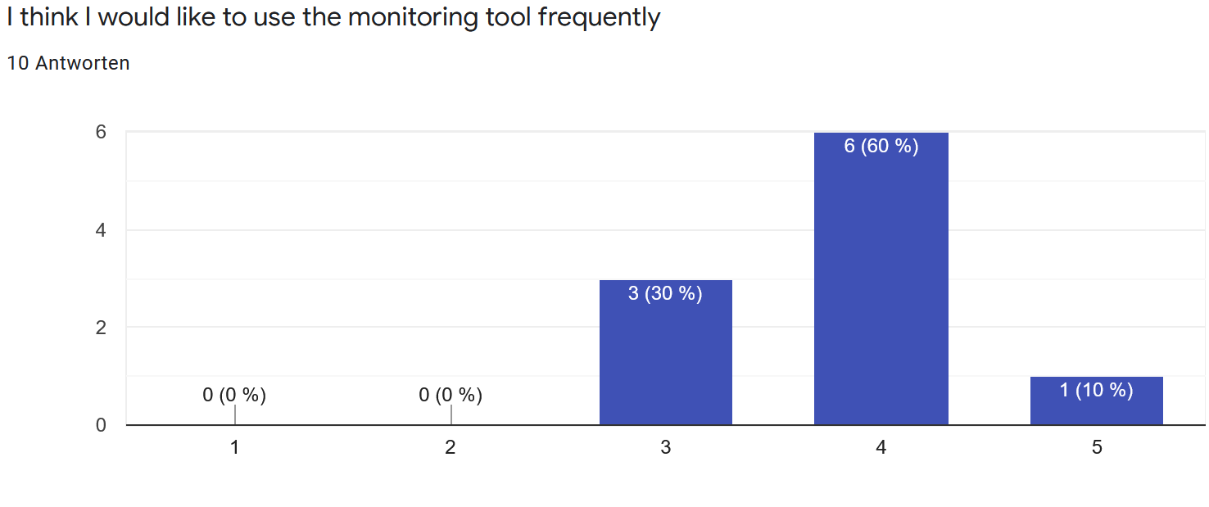
Regular Usage

Slide 53
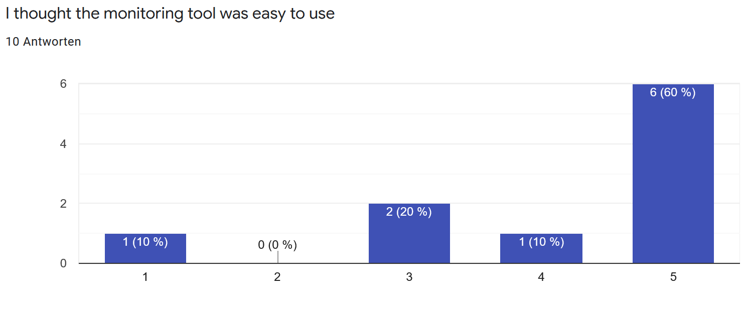
Easy to Use

Slide 54
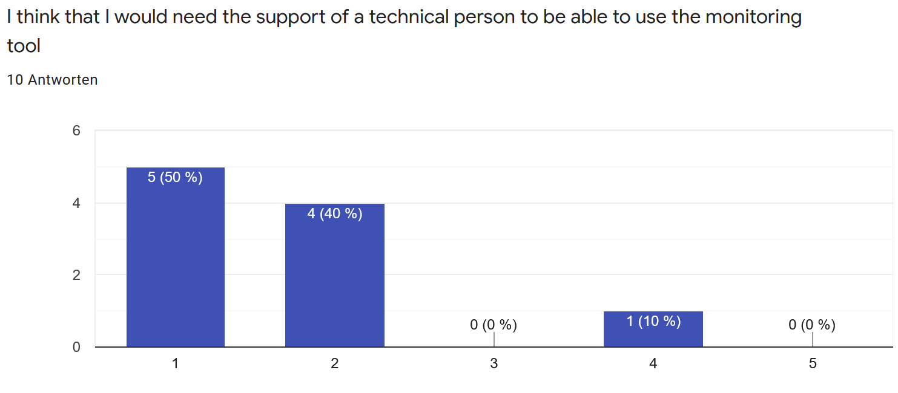
Help for Usage

Slide 55
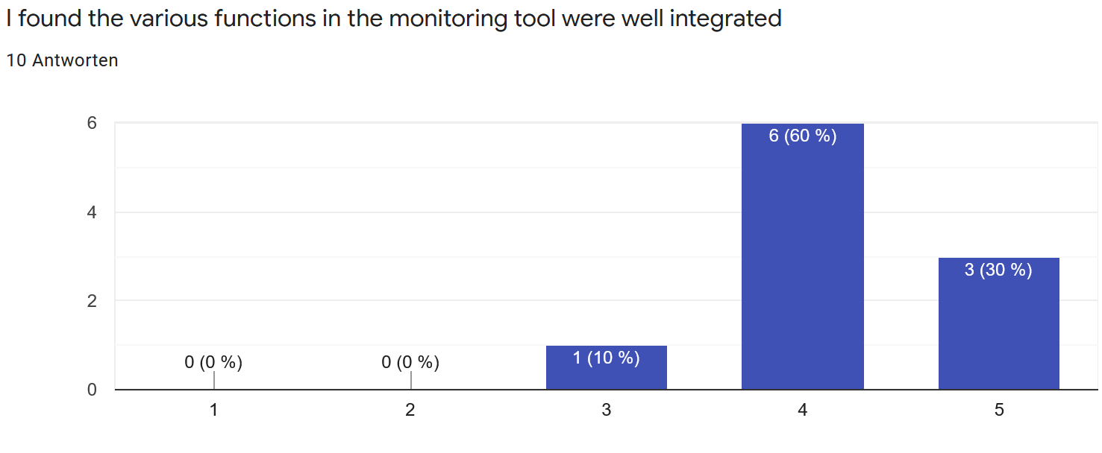
Integration of the functionalities

Slide 56
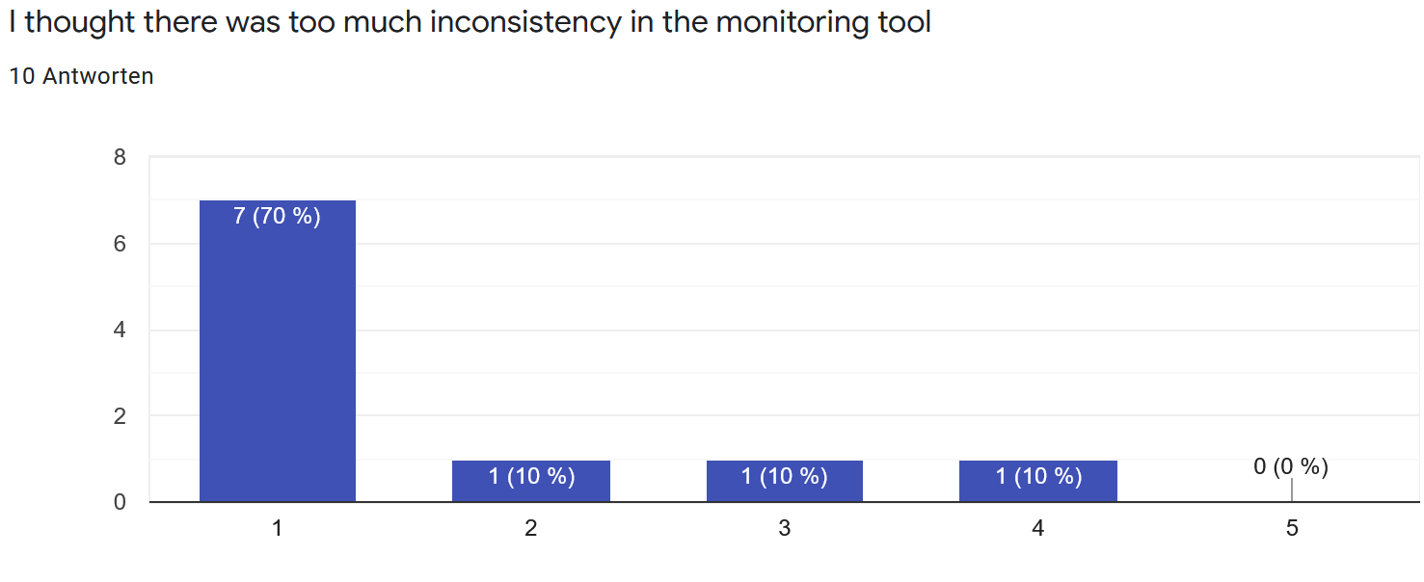
Inconsistency of the monitoring tool

Slide 57
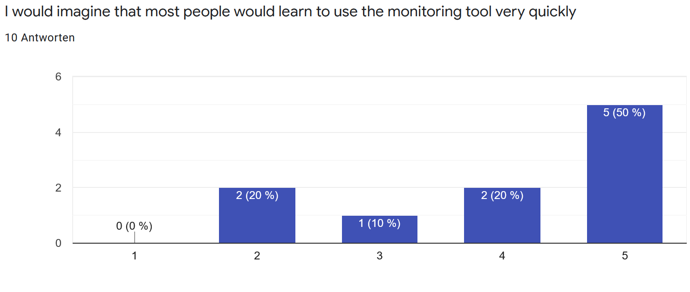
Quick learning

Slide 58
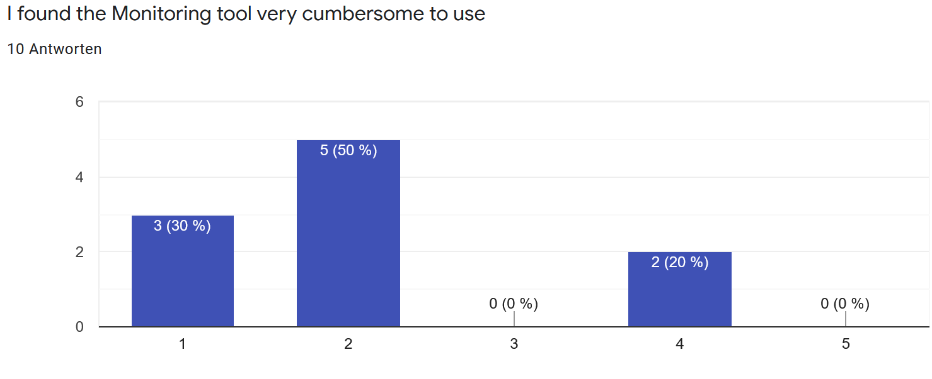
Cumbersome Usage

Slide 59
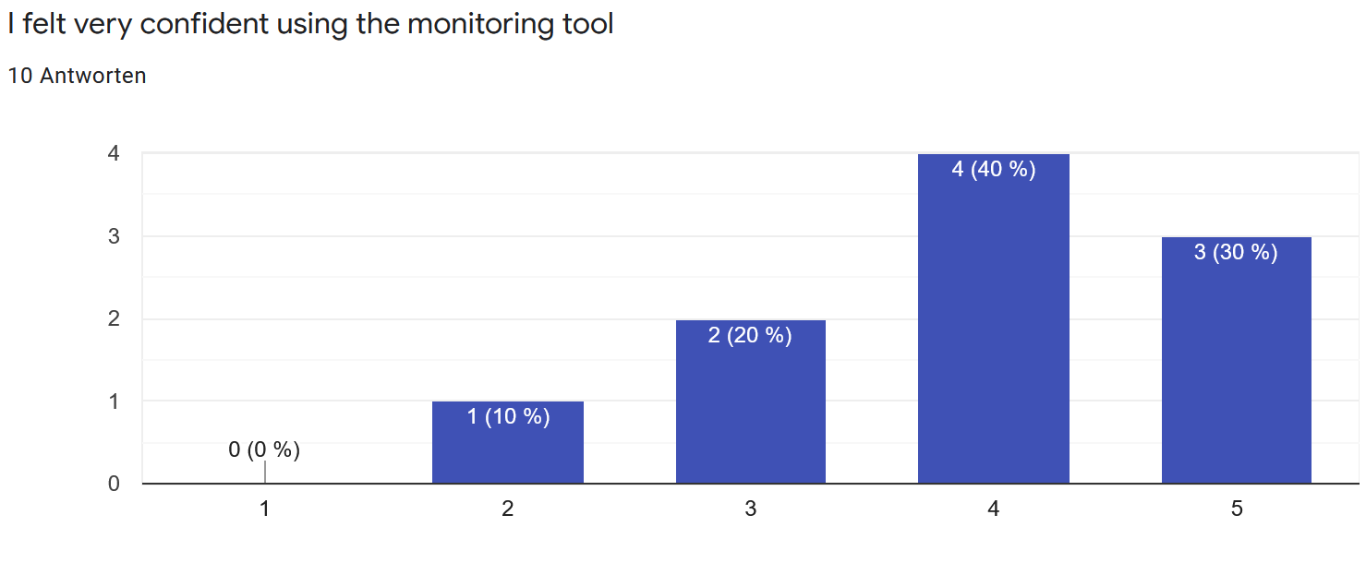
Confidence while Using the monitoring tool

Slide 60
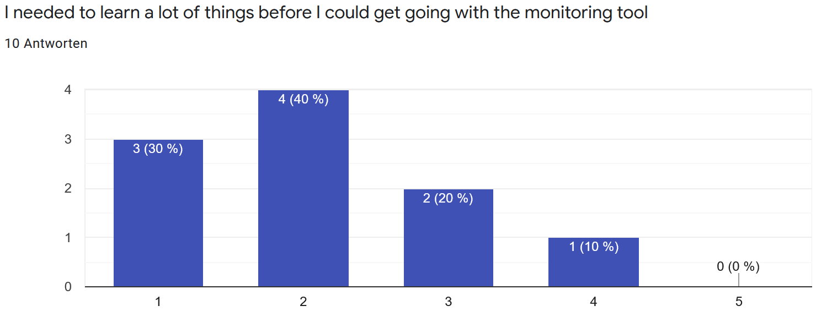
Preknowledge before using the monitoring tool

Slide 61
SUS score calculation
Question 1 | 3,8 | Question 2 | 1,4
Question 3 | 4,1 | Question 4 | 1,7
Question 5 | 4,2 | Question 6 | 1,6
Question 7 | 4,0 | Question 8 | 2,1
Question 9 | 3,9 | Question 10 | 2,1
Total Odd: | 20 | Total Even: | 8,9
Result: | 20 – 5 = 15 | Result: | 25 – 8,9 = 16,1
SUS Score | (15 + 16,1) * 2,5 = 77,75

Slide 62
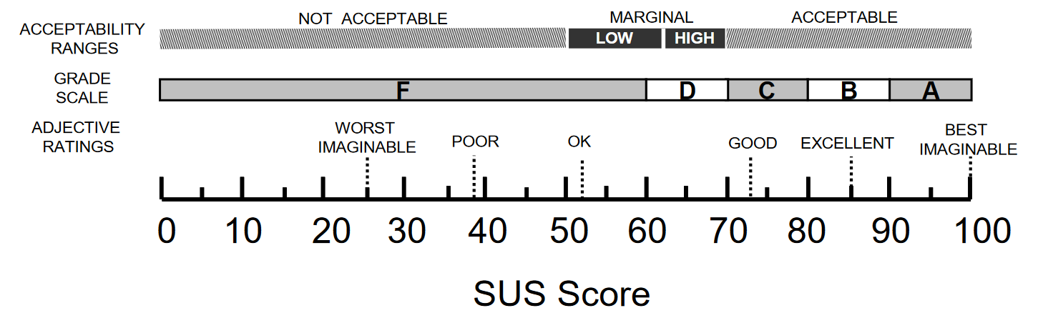
SUS score interpretation

